Slide 1


Confidential
Digital Transformation and IT Strategy Toolkit
Overview

Slide 2


Introduction
This Digital Transformation and IT Strategy Toolkit was created by ex-McKinsey, Deloitte and BCG Management Consultants, after more than 5,000 hours of work. It is considered the world's best & most comprehensive Digital Transformation and IT Strategy Toolkit. It includes all the Frameworks, Best Practices & Templates required to successfully undertake the Digital Transformation of your organization and define a robust IT Strategy.
Join the 200,000+ Executives, Consultants & Entrepreneurs who are already leveraging our Management Consulting Toolkits to improve the performance of their organization and boost their own career.
If you have any questions, send us an email at support@domontconsulting.com and one of our ex-McKinsey, Deloitte & BCG Management Consultants will get back to you within 2 business days.
Aurelien Domont
Management Consultant
Domont Consulting Managing Director

Slide 3

Context: With 50 billion connected devices in use by 2030, undertaking a successful digital transformation is becoming more important than ever
Number of connected devices worldwide
50 billion
38 billion
22 billion
2018
2025
2030
Source: Statista

Slide 4
Problem #1: Transformations are hard, and digital ones are harder
Digital transformation failure rate¹
Main reasons for failure²
Resistance to Change
Lack of Clear Strategy
Inadequate Leadership Support
Insufficient Skills and Training
Poor Change Management
Success rate
Failure rate
These percentages are approximate and can vary based on the specific context and industry. Successful digital transformation requires addressing these challenges proactively and fostering a culture of adaptability and innovation
Source: (1) McKinsey survey, (2) Investopedia survey

Slide 5
Problem #2: Many companies fail to define and implement their IT Strategy
There are 7 key reasons that explain why so many companies fail to define and implement their IT Strategy:
Lack of Strategic Alignment
When IT strategy isn’t closely aligned with the corporate and business strategy, it can lead to inefficiencies and wasted resources. Ensuring that IT initiatives directly support the organization’s mission is crucial.
Insufficient Communication
Poor communication between IT teams and other departments hinders successful strategy execution. Clear communication channels and collaboration are essential.
Resistance to Change
Employees may resist adopting new technologies or processes. Overcoming this resistance requires effective change management and training.
Inadequate Resources
Insufficient budget, talent, or infrastructure can hinder strategy implementation. Proper resource allocation is vital.
Changing Priorities
Business needs evolve, and IT strategies must adapt accordingly. Failing to adjust can lead to obsolescence.
Lack of Leadership Support
Without strong executive sponsorship, IT strategies often falter. Leadership commitment is critical.
Overcomplexity
Overly complex strategies can overwhelm teams. Simplicity and clarity are key

Slide 6












Solution: Our firm created a Digital Transformation and IT Strategy Toolkit to help you significantly increase your odds of success
What’s inside the Toolkit?
Who created the Toolkit?
The Toolkit was created ex-McKinsey, Deloitte and BCG Management Consultants.
Best Practices
Frameworks
Number of professionals leveraging our Toolkits
Advice from
tier-1 Management Consultants
Tools
There are 200,000+ Executives, Consultants & Entrepreneurs leveraging our Toolkits to improve the performance of their organization
Real-life Examples
Templates
Trusted by small and large organizations
Video Training
Step-by-step Tutorials

Slide 7
The Toolkit will help you fulfill multiple objectives
The Digital Transformation and IT Strategy Toolkit includes frameworks, tools, templates, tutorials, real-life examples, video training, and best practices to help you:
Carry out a Business Case for Change: (1) Situation & key challenge, (2) Recommendation to launch a digital transformation, (3) Reasons for launching a digital transformation, such as “an increasingly digitally friendly world”, “a low digital maturity within our organization”, “an opportunity to generate additional revenue”, “an opportunity to decrease our costs”, “a great return on investment”, and “a perfect alignment with the corporate and business strategy”
Define the Digital Transformation Strategy: (1) Key success factors, (2) Digital transformation program team and budget, (3) Current and target digital maturity level, (4) Digital transformation vision, (5) Digital transformation strategic objectives to reach our vision, (6) Potential projects to reach our strategic objectives, (7) Business cases and financial models to prioritize our potential projects, (8) Project prioritization, (9) Digital transformation roadmap including our prioritized projects, (10) Required technologies to implement the projects
Create strategic dashboards: (1) Annual, quarterly and monthly overall performance dashboards, (2) Revenue and profit actuals and estimates, (3) Sales and cost breakdown analysis, (4) Three financial statement model, (5) Other common charts
Define a robust IT Strategy that will enable your business strategy and Digital Transformation: (1) Enterprise Architecture, (2) Summary of the Corporate & Business Strategy, (3) Current & Target IT Capability Maturity Levels, (4) IT Vision, Mission & Values, (5) IT Value Drivers, (6) IT Strategic Objectives & KPIs to reach our Vision, (7) IT Team & Budget, (8) IT Guiding Principles
Define the key pillars required to implement your IT Strategy: (1) IT Operating model, (2) Technology, (3) Data Management & Infrastructure, (4) IT Services, (5) Sourcing & Procurement Strategy
List your potential initiatives for each pillar
Create your business cases and financial models to assess potential initiatives
Prioritize, plan and implement your projects: (1) Project prioritization, (2) Business roadmap, (3) Governance, (4) Dashboards, (5) Project implementation: agile methodology, design thinking and traditional methodology, (6) Continuous improvement (7) Post program/projects evaluation and lessons learnt
Define and implement your change management strategy and internal communication strategy: (1) Change management strategy, (2) Change management plans, (3) Implementation, tracking and progress management, (4) Effective communication

Slide 8
The Toolkit includes 2 sections
1
Digital Transformation
2
IT Strategy

Slide 9





The Digital Transformation section includes a 5-phase approach that we have built and refined over the past 20 years
Why?
What?
How?
I. Carry out a Business Case for Change
II. Define the Digital Transformation Strategy
III. Implement, Track & Manage Progress
Situation & key challenge
Recommendation to launch a digital transformation
Reasons for launching a digital transformation
An increasingly “digitally friendly” world
A low digital maturity within our organization
An opportunity to generate additional revenue
An opportunity to decrease our costs
A great return on investment
A perfect alignment with the corporate and business strategy
Key success factors
Digital transformation program team and budget
Current and target digital maturity level
Digital transformation vision
Digital transformation strategic objectives to reach our vision
Potential projects to reach our strategic objectives
Business cases and financial models to prioritize our potential projects
Project prioritization
Digital transformation roadmap including our prioritized projects
Required technologies to implement the projects
Digital transformation program governance
Digital transformation program dashboards
Projects dashboards
Projects plans
Projects implementation using Agile
Projects implementation using Design Thinking
Projects implementation using the Traditional methodology
Continuous improvement
Program/project evaluation and lessons learnt
IV. Define and Implement the Change Management Strategy and Internal Communication Strategy
V. Strategic Dashboards

Slide 10




The IT Strategy section includes a 6-phase approach that will enable your business strategy and digital transformation
I. IT Strategy to enable our Digital Transformation
Enterprise Architecture
Summary of the Corporate & Business Strategy
Current & Target IT Capability Maturity Levels
IT Vision, Mission & Values
IT Value Drivers
IT Strategic Objectives & KPIs to reach our Vision
IT Team & Budget
IT Guiding Principles
II. 5 Pillars to implement our IT Strategy
IT Operating model
Technology
Data Management & Infrastructure
IT Services
Sourcing & Procurement Strategy
“Diversification” operating model
“Coordination” operating model
“Replication” operating model
“Unification” operating model
Key processes
Big data
Artificial Intelligence
Cloud Computing
Cyber Security
Blockchain
Internet of Things
Digital Marketing
3-D Printing
Drones
Robots
Virtual Reality
Augmented reality
Data sources and acquisition
Data storage and processing solutions
Data integration, transformation & ETL Processes
Data quality & cleansing
Data infrastructure scalability & performance
Emerging technologies in data management and infrastructure
Successful implementations
IT service strategy
IT service design
IT service transition
IT service operation
IT continual service improvement
Guiding principles and governance
Overview and best practices of the function “Sourcing & Procurement”
Maturity model
Key performance indicators (KPIs)
Current state and target state of the company
III. Potential Initiatives for each Pillar
IV. Business cases and financial models to assess potential Initiatives
V. Project Prioritization, Business Roadmap and Implementation
VI. Change Management, Internal Communication and Stakeholder Engagement

Slide 11
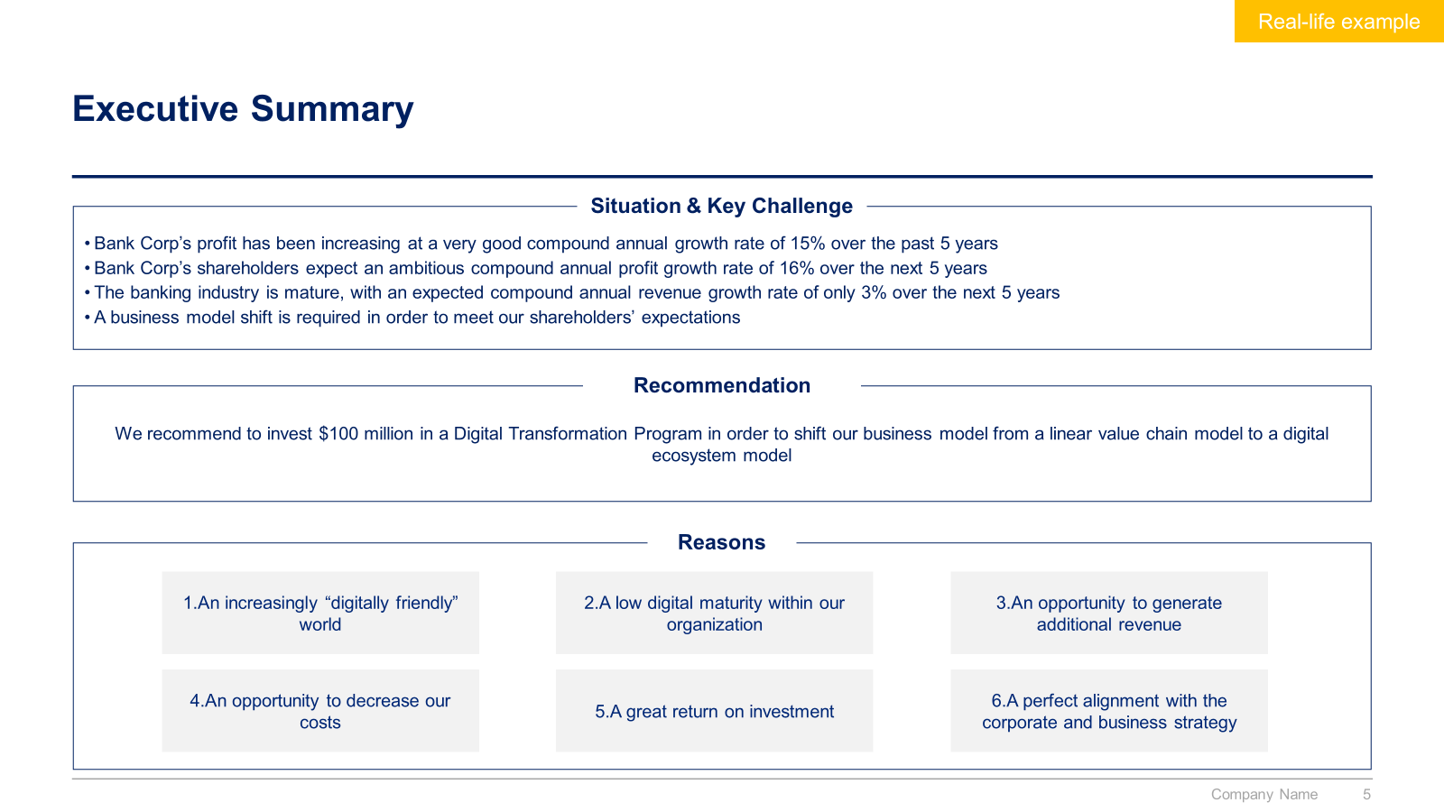
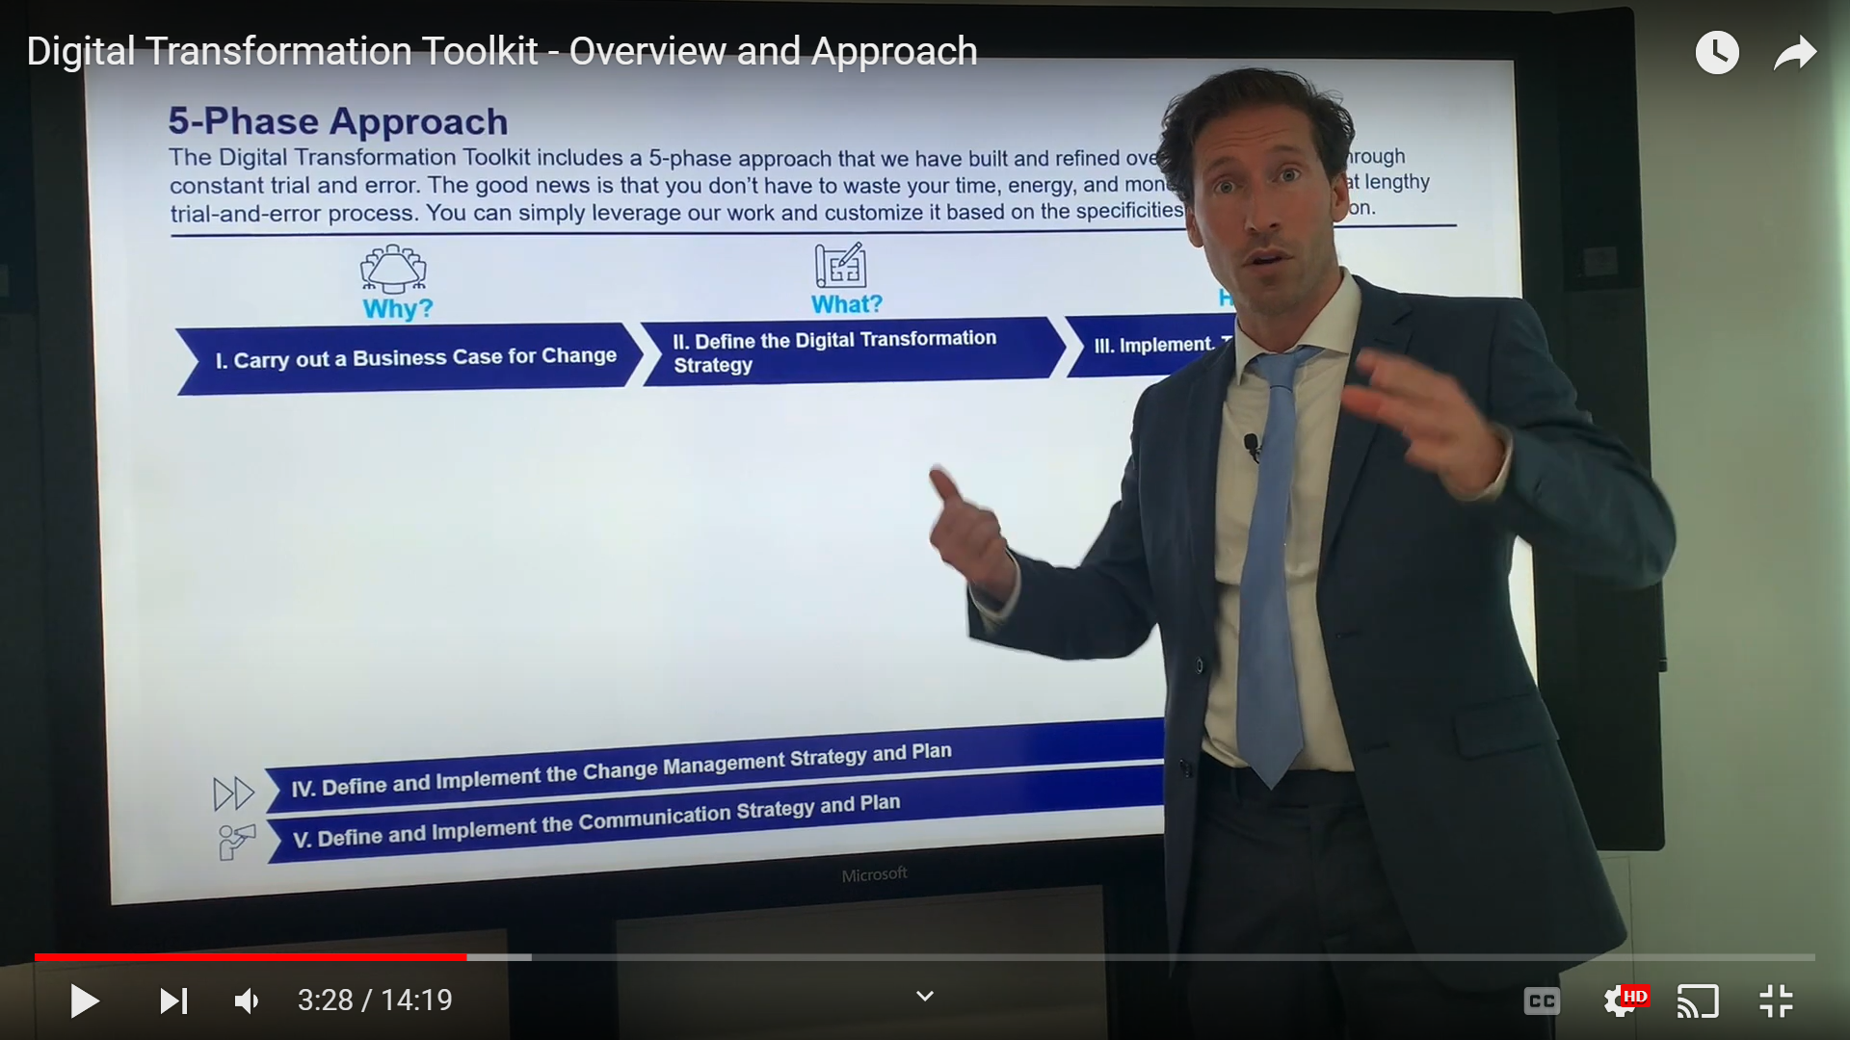
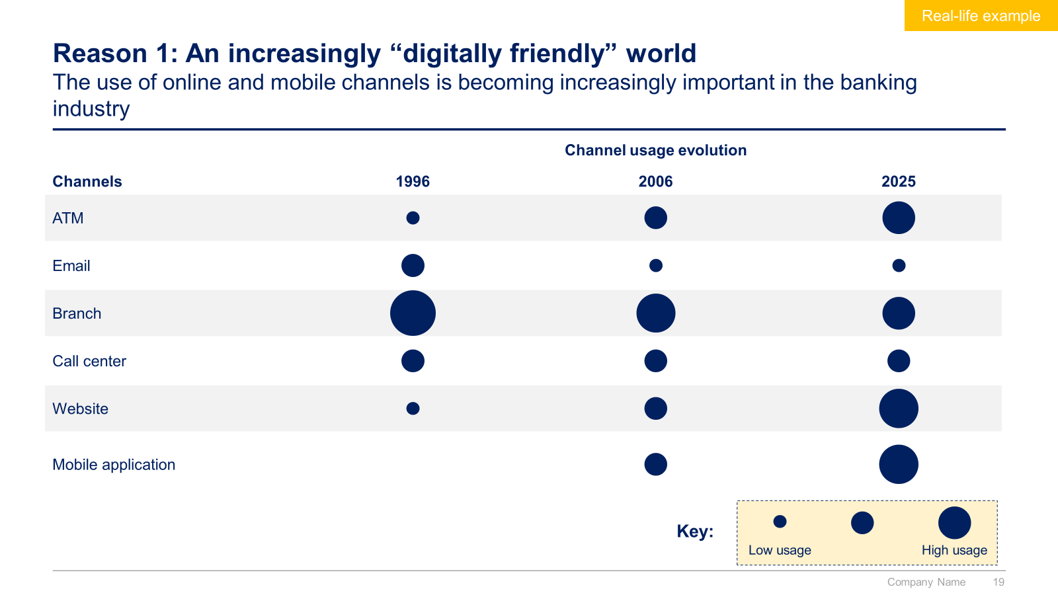
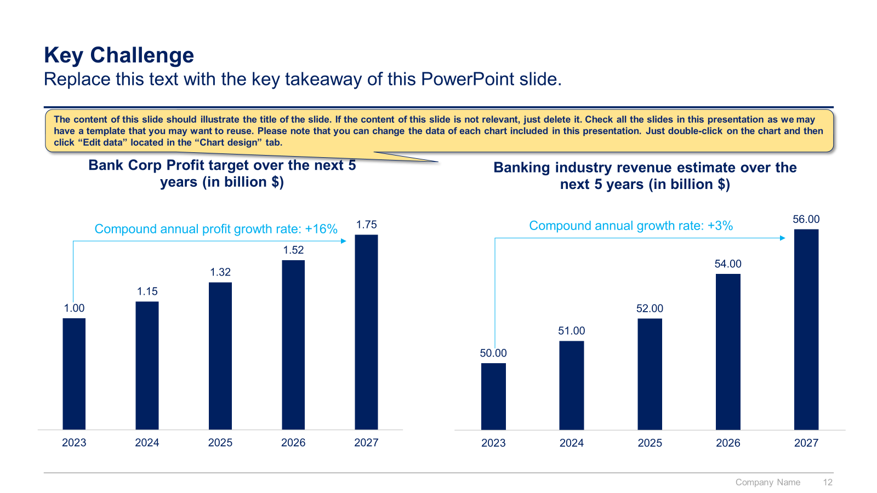
Digital Transformation section: Small preview of the phase I “Carry out a Business Case for Change”

Slide 12
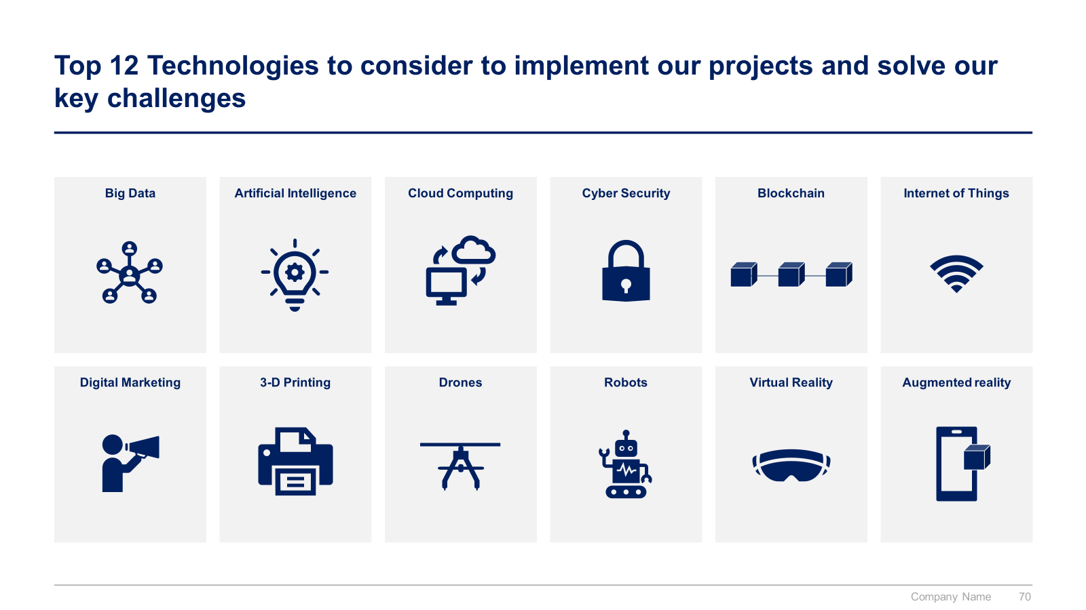
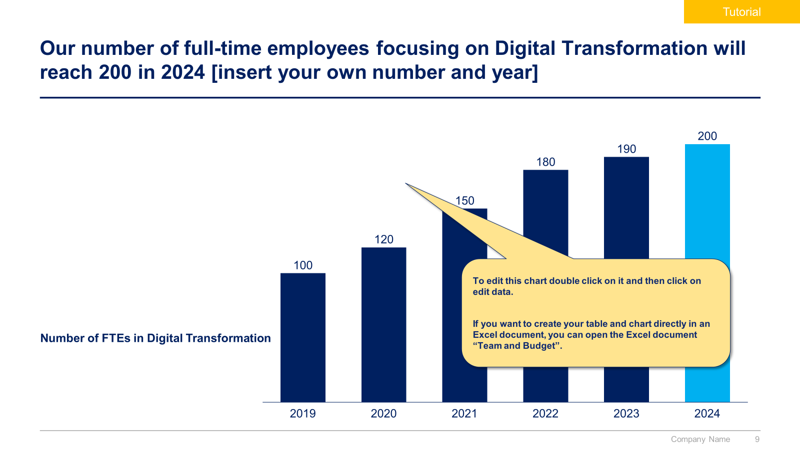
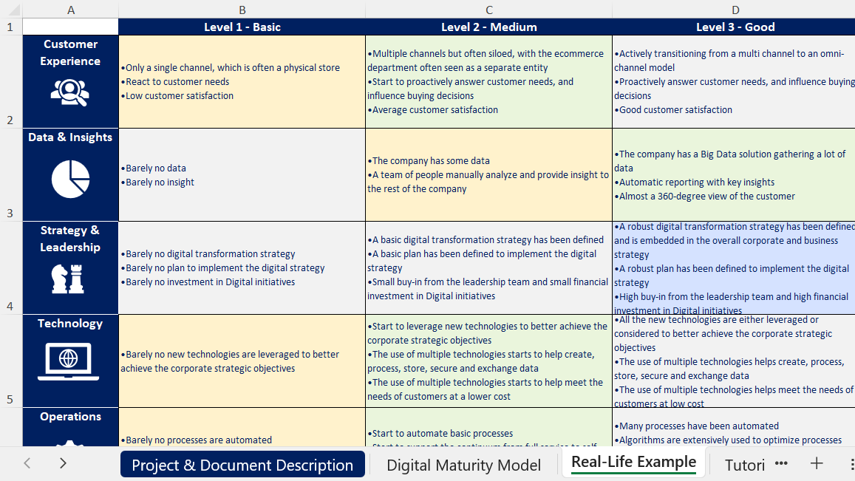
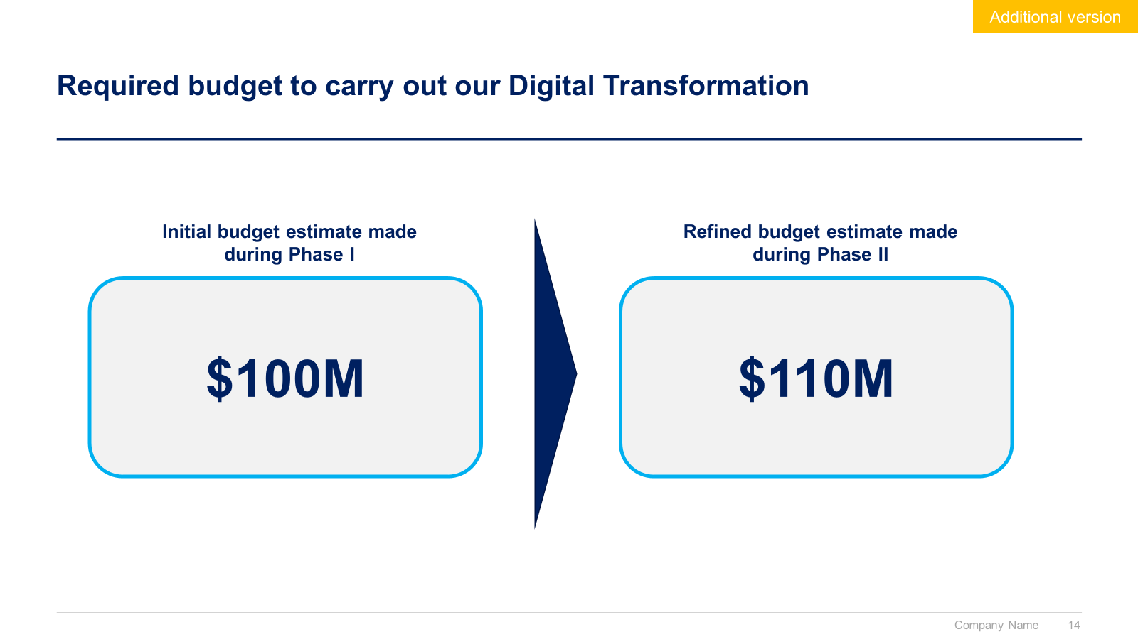
Digital Transformation section: Small preview of the phase II “Define the Digital Transformation Strategy”

Slide 13
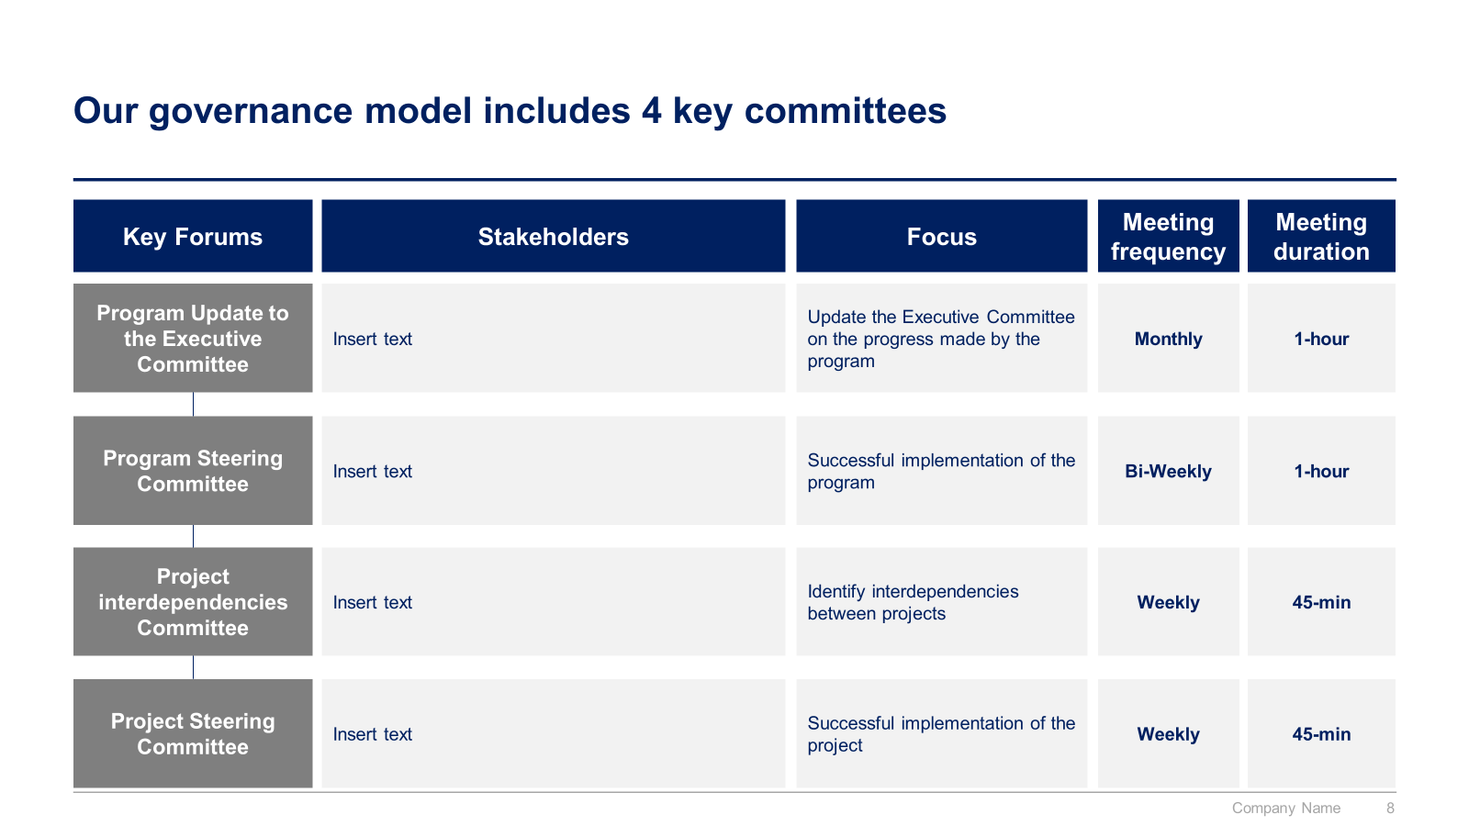
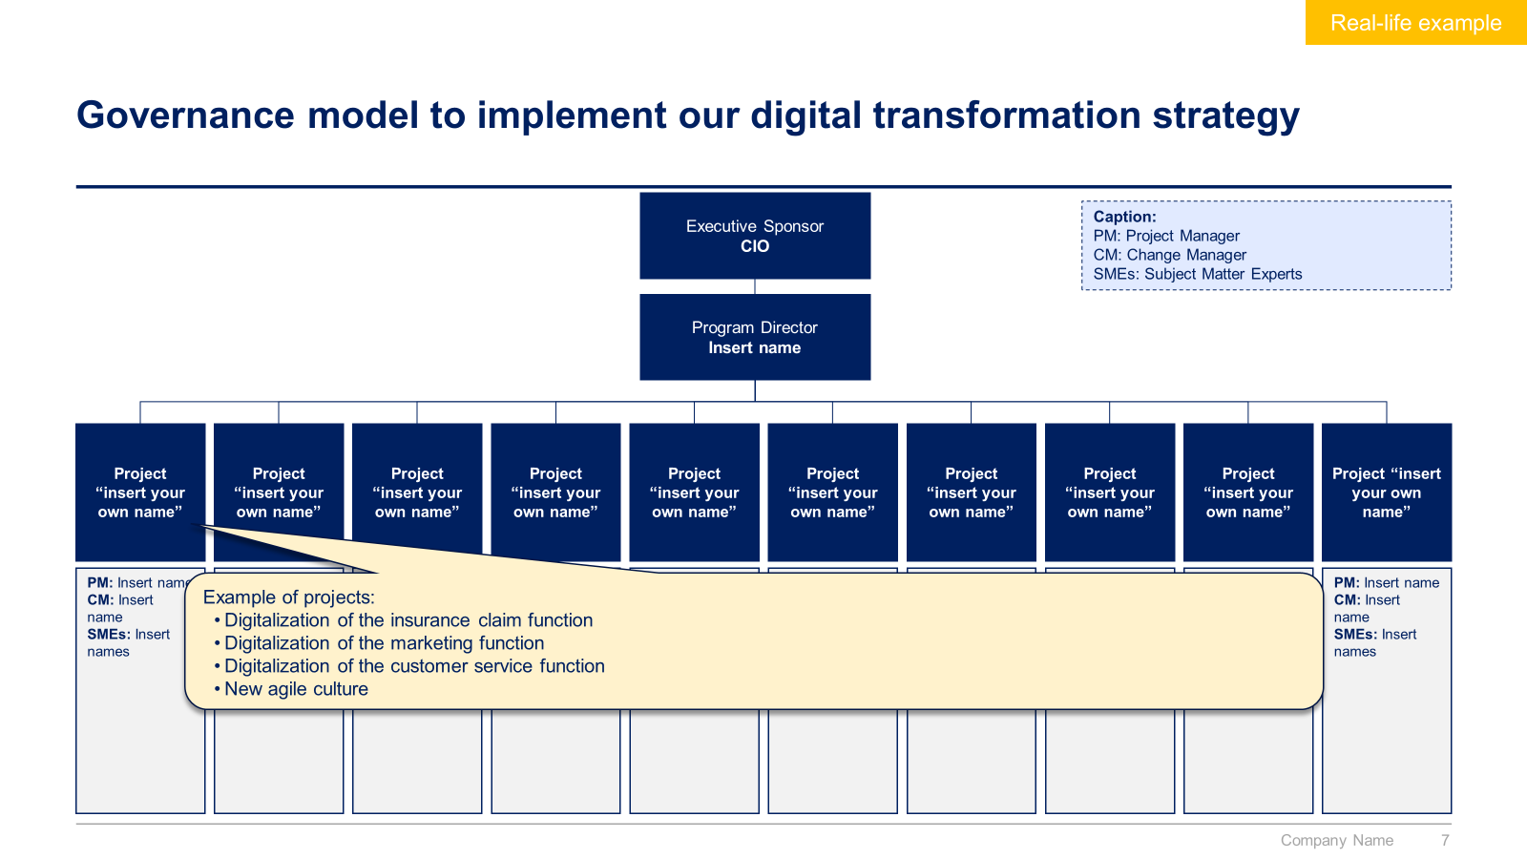
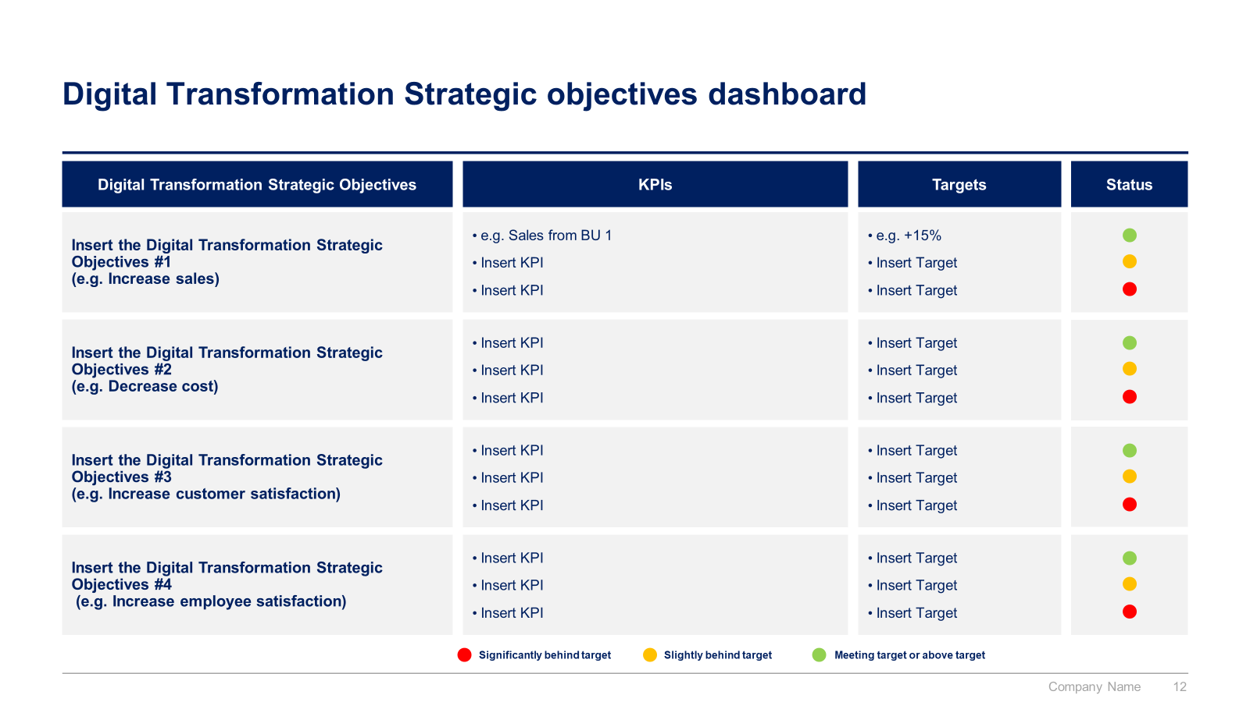
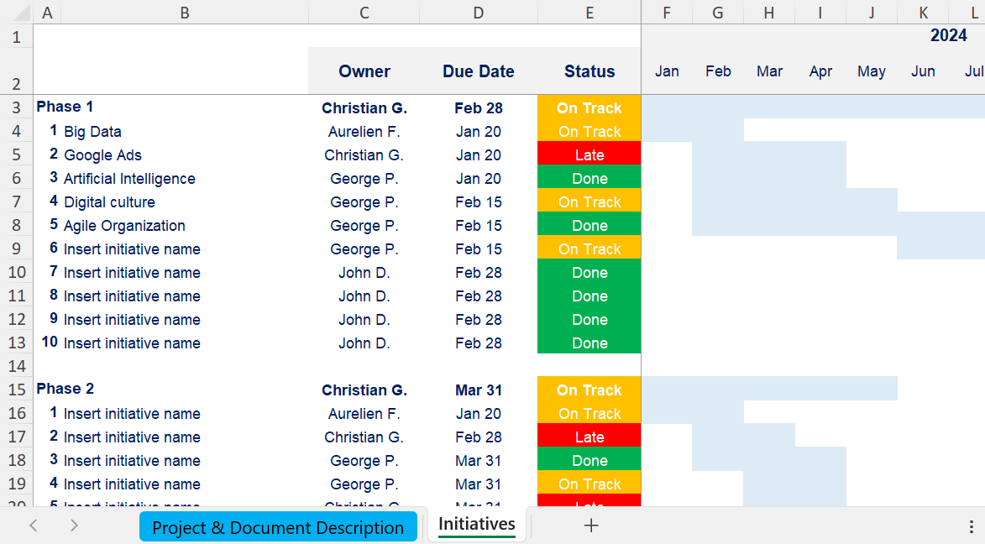
Digital Transformation section: Small preview of the phase III “Implement, Track & Manage Progress”

Slide 14
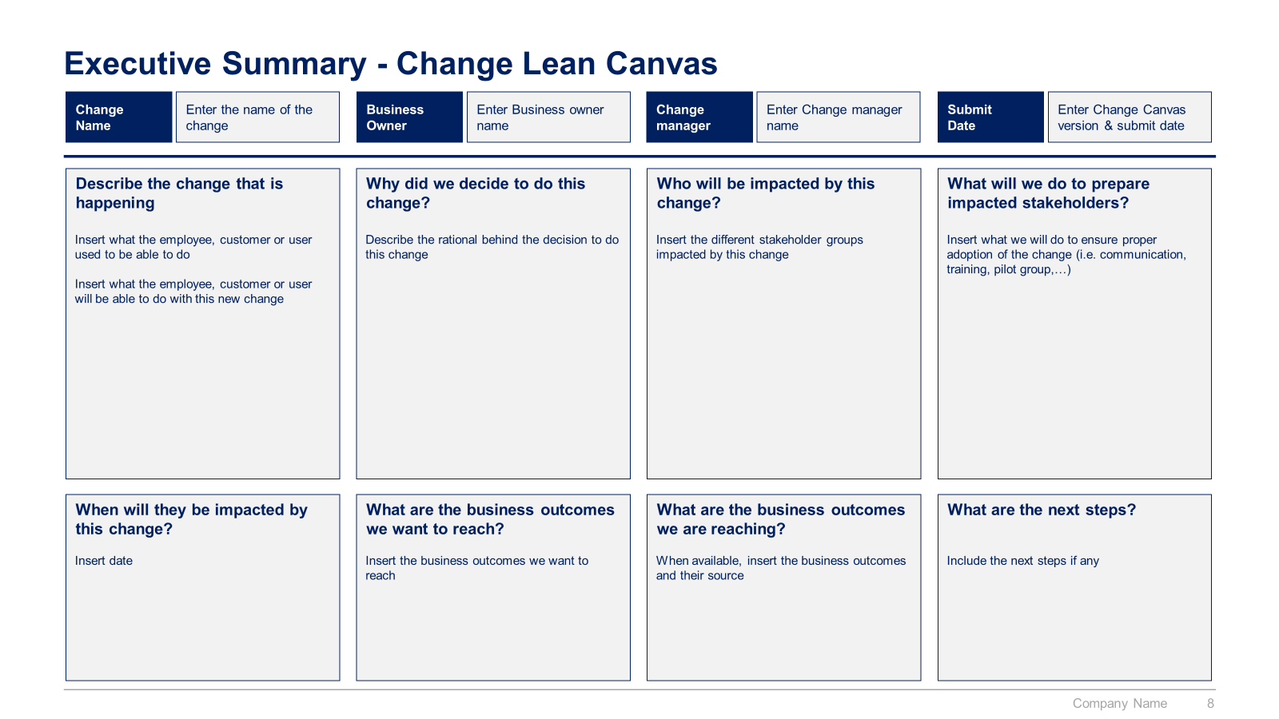
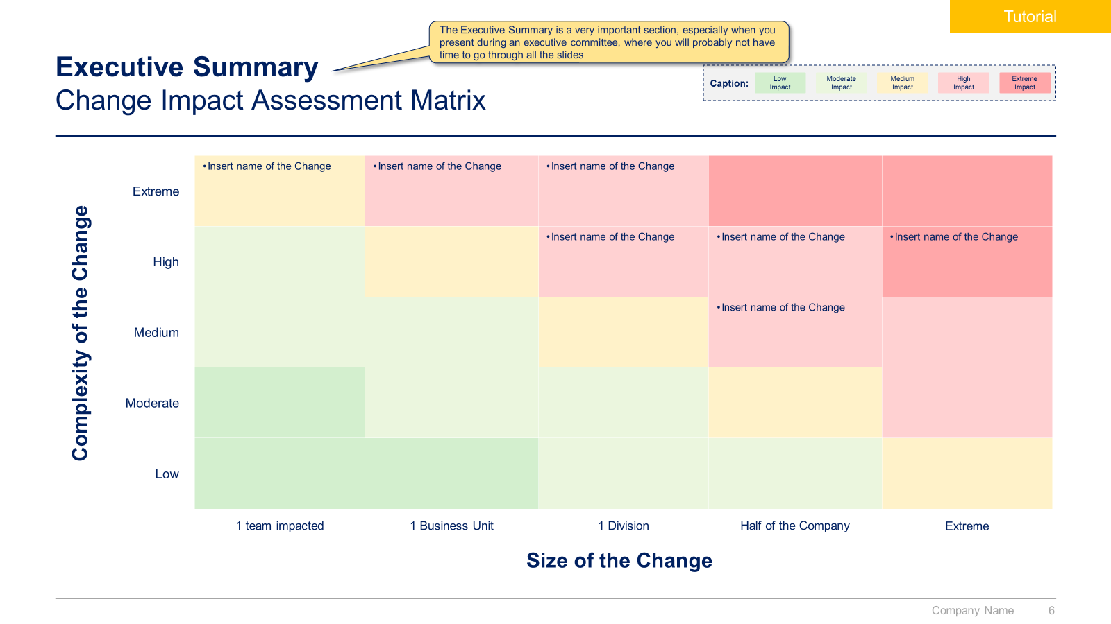
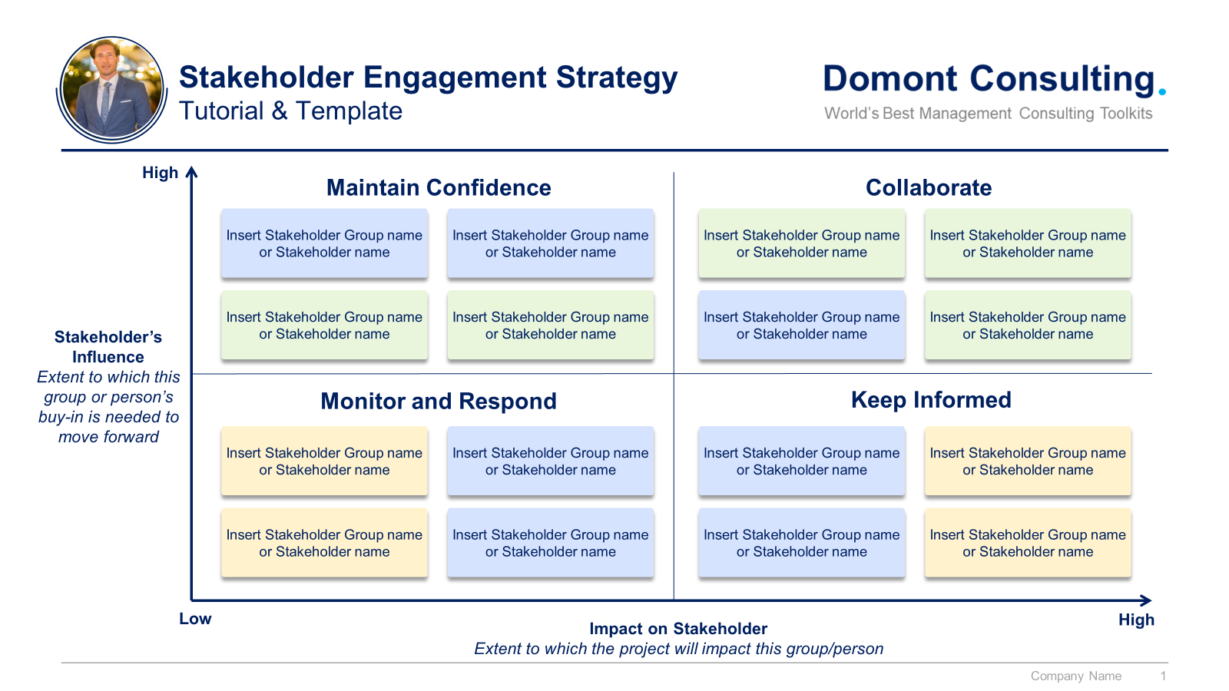
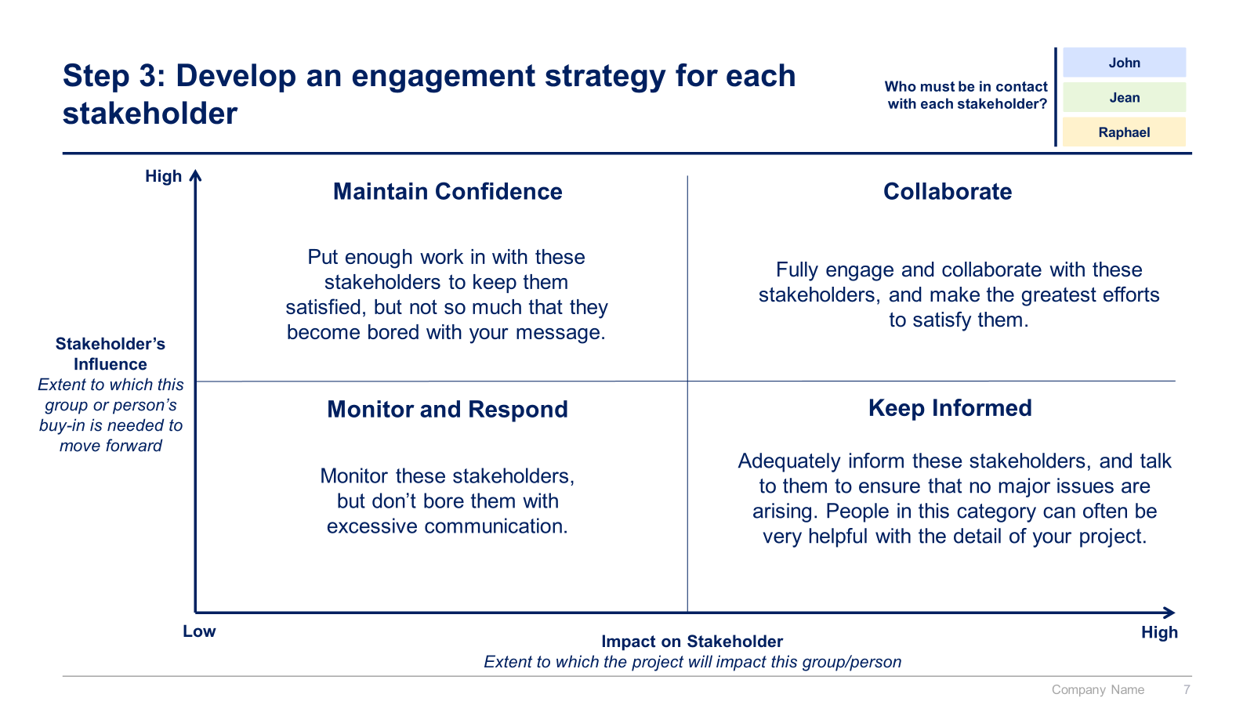
Digital Transformation section: Small preview of the phase IV “Change and Communication” and V “Strategic Dashboards”

Slide 15
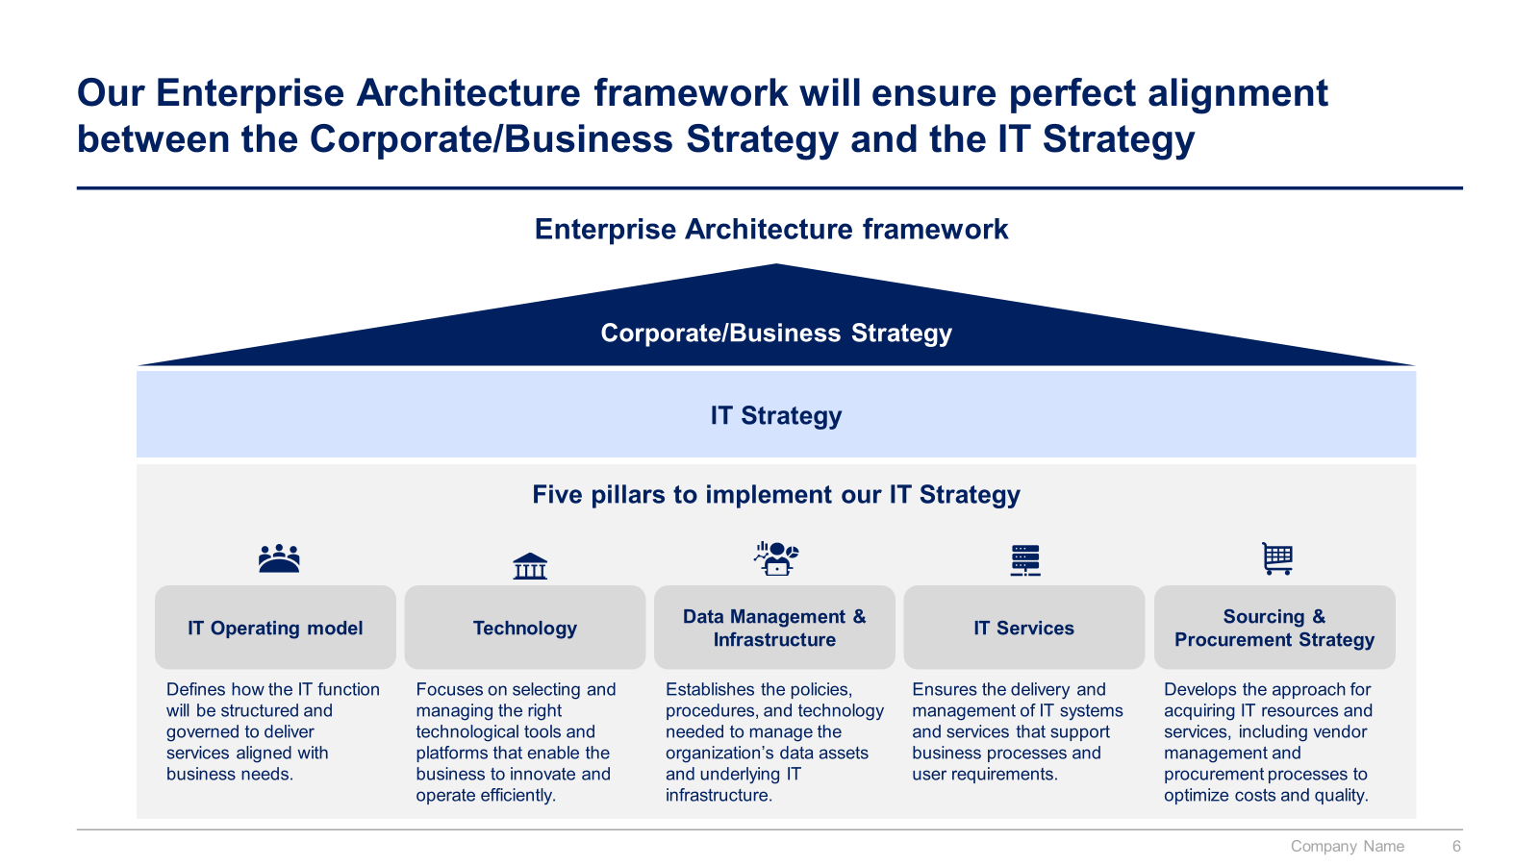
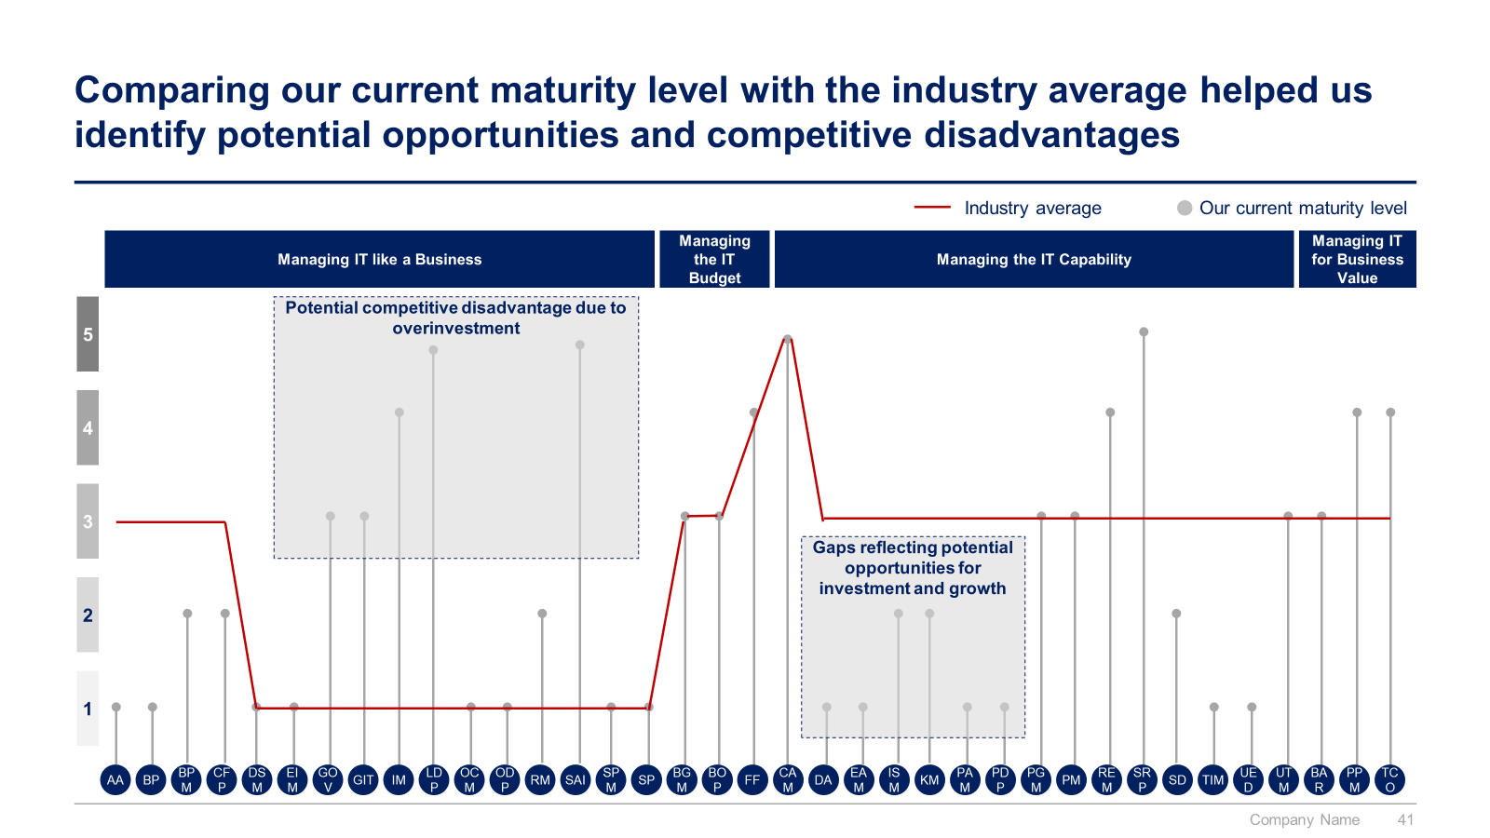
IT Strategy section: Small preview of the phase I “IT Strategy”

Slide 16
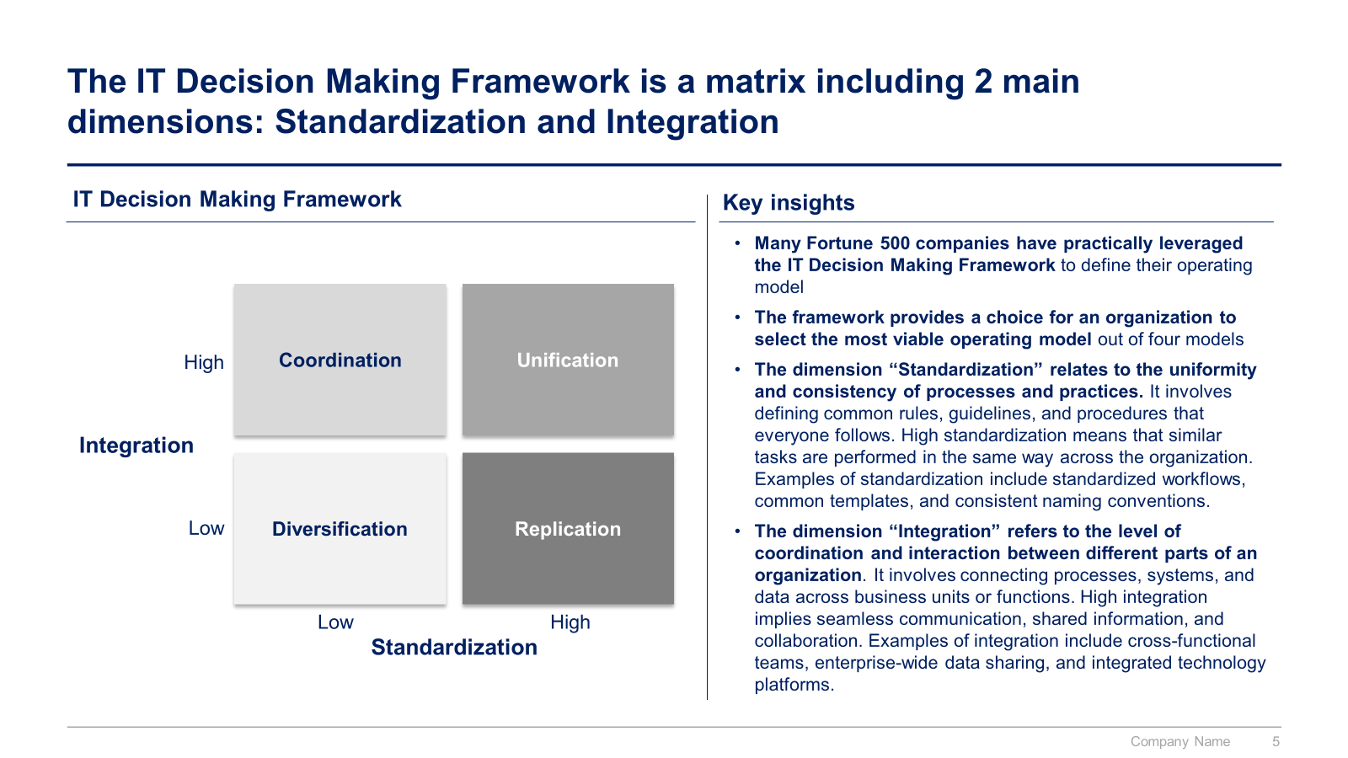
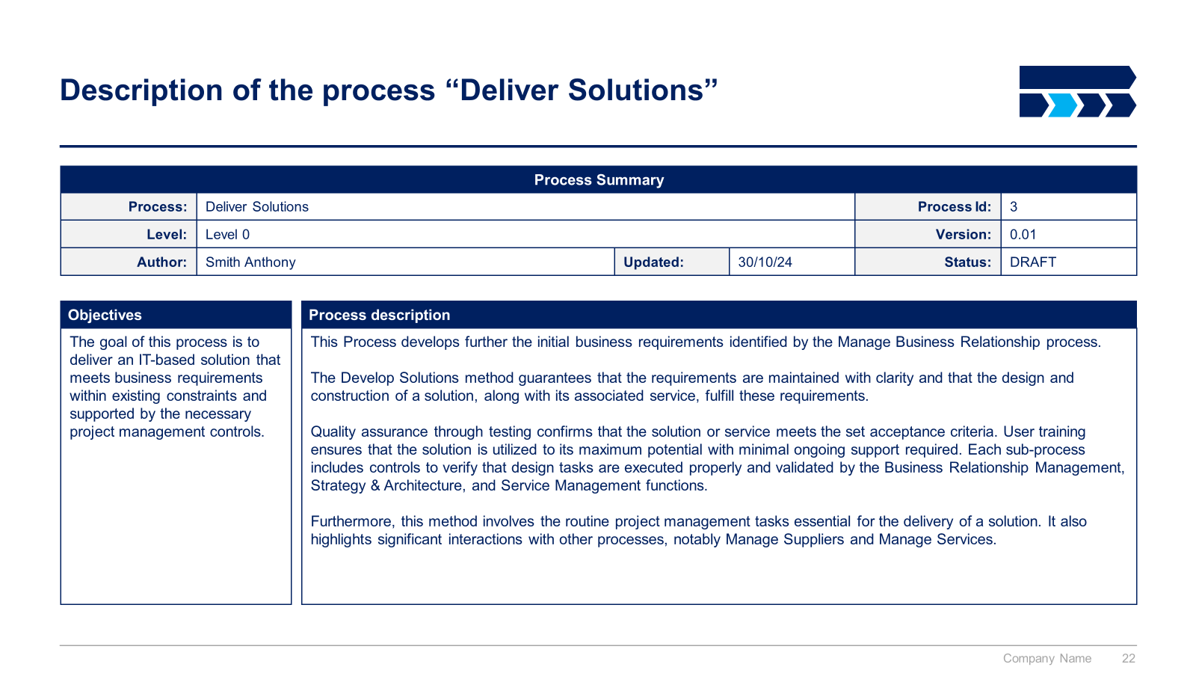
IT Strategy section: Small preview of the phase II “5 Pillars to implement our IT Strategy”

Slide 17
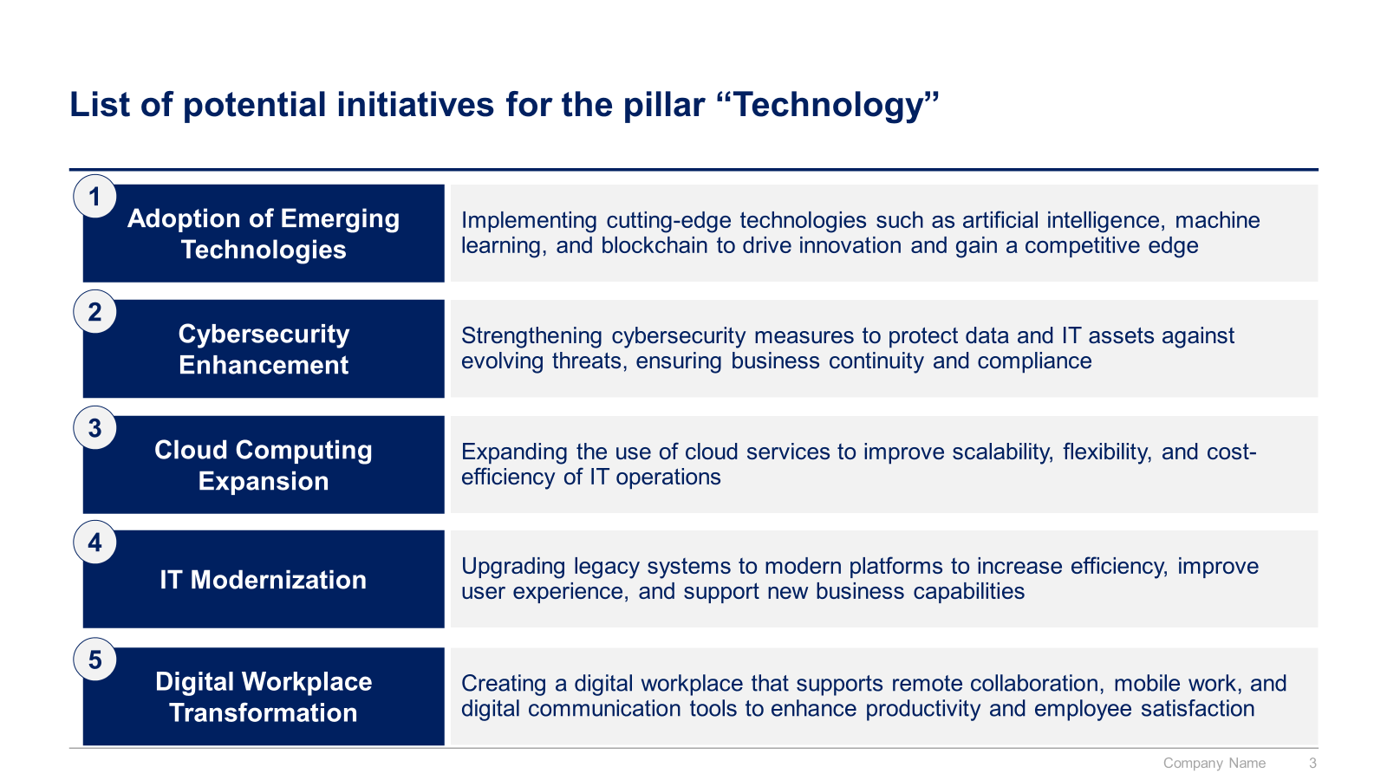
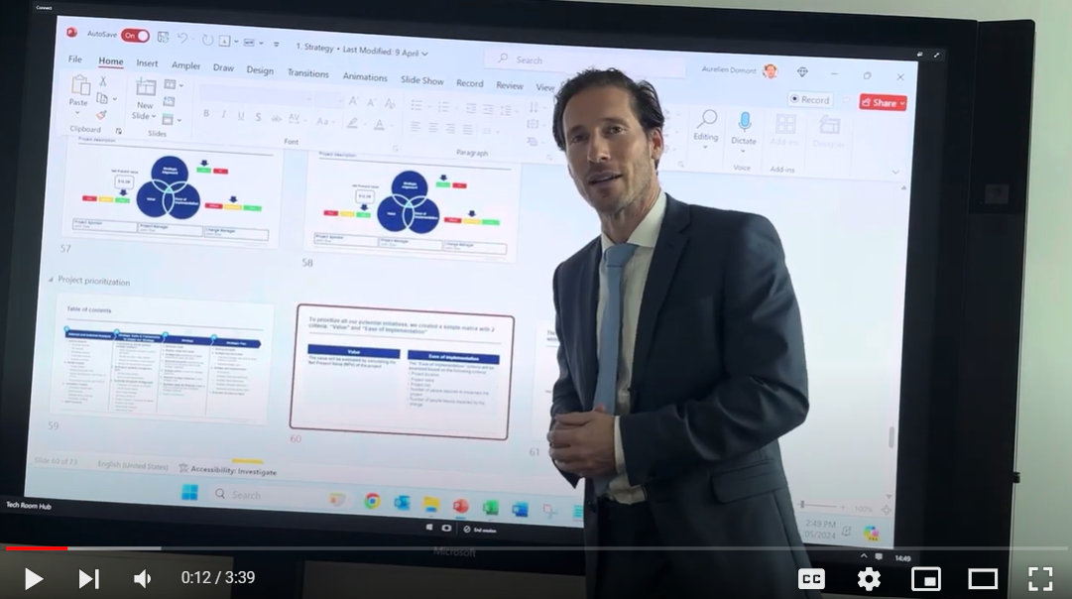
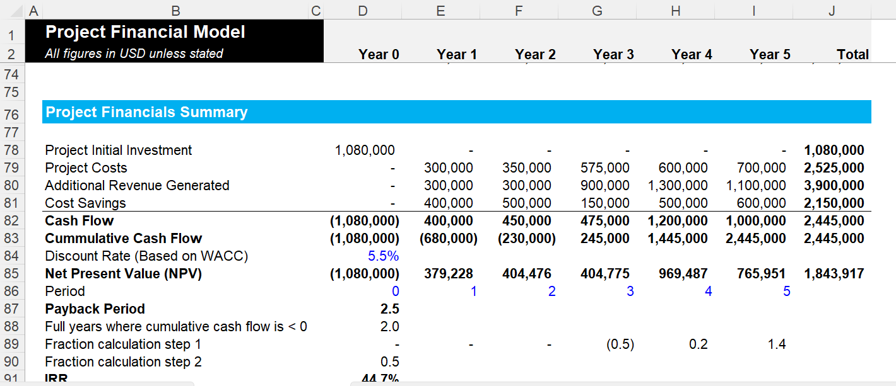
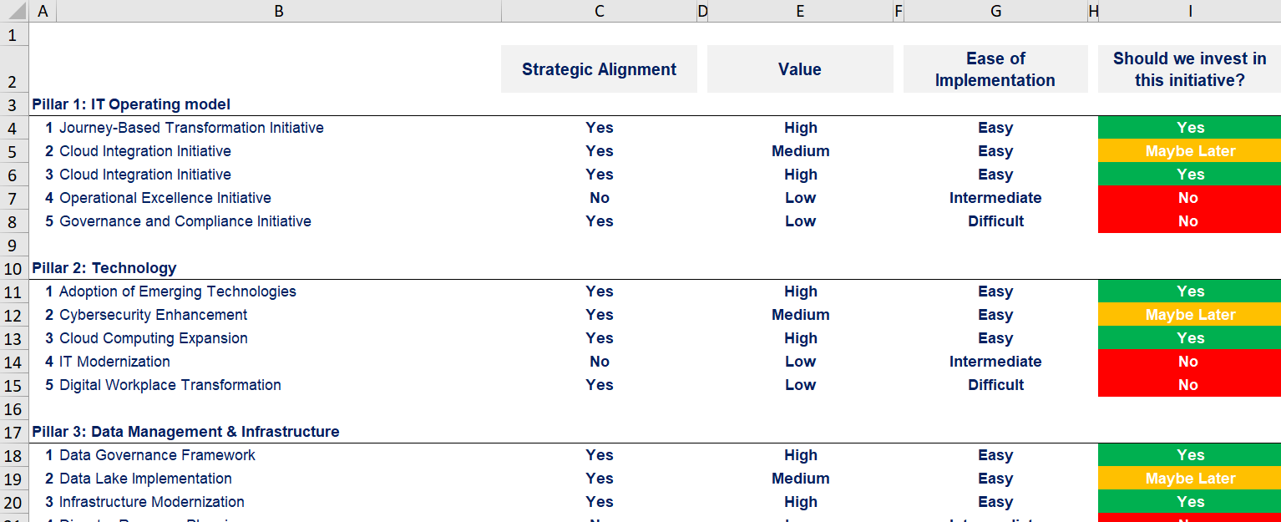
IT Strategy section: Small preview of the remaining phases

Slide 18




The Toolkit includes multiple PowerPoint slides, Excel sheets and Video training that you can download on your device immediately after purchase
800 editable PowerPoint slides*
40 Excel sheets*
88 minutes of Video training
Approach and Overview
Digital Transformation
IT Strategy
*Please note that the number of Powerpoint slides and Excel sheets listed is the number of unique slides and sheets. For example, a Powerpoint slide that has been duplicated to facilitate our clients’ understanding only counts for one slide

Slide 19









Our Management Consulting Toolkits include 9 key benefits
Improve the growth & efficiency of your organization by leveraging Management Consulting Toolkits created by ex-McKinsey, Deloitte & BCG Consultants.
Make a great investment for your career & organization. It cost us US$8M+ over the past 10 years to create all our Toolkits. Get them for a fraction of this cost.
Get a competitive advantage. It’s like hiring Management Consultants to create all the practical Frameworks, Tools & Templates you need.
Get the job done quicker and never start from scratch again with our ready-made and fully editable Frameworks, Tools & Templates in Powerpoint & Excel.
Don't reinvent the wheel. We have already worked 30,000+ hours over the past 10 years to create all the Management Consulting Toolkits you need.
Improve the capabilities of your organization by learning how the Fortune 100 and Global Consulting Firms do it.
Decrease your costs. Hiring tier-1 Consultants for a project would cost you $300k+. Way more expensive than our Toolkits, which will last you a lifetime!
Become your organization’s subject matter expert and impress your stakeholders with world-class approaches to resolve common business problems.
Get free support and advice from our ex-McKinsey, Deloitte & BCG Management Consultants.

Slide 20
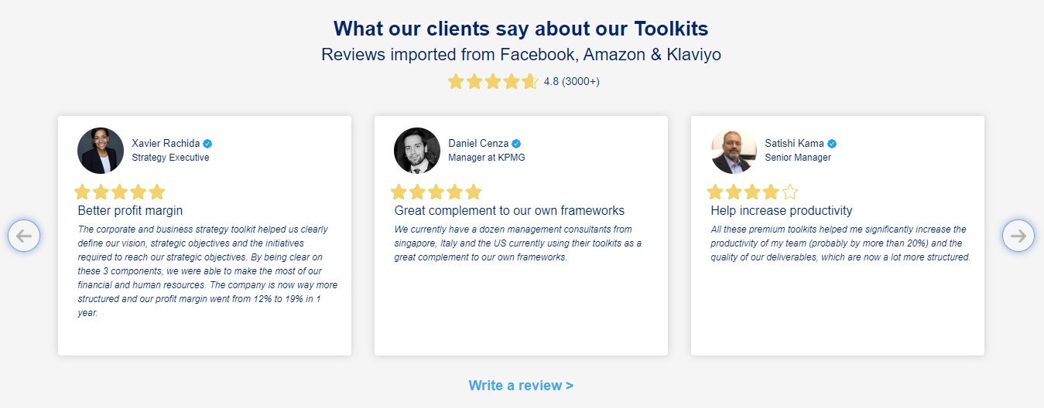
What our clients say about our Toolkits
Click here to see more reviews >

Slide 21

Join 200,000+ Executives, Consultants & Entrepreneurs leveraging our Toolkits to improve the performance of their organization
Trusted by small and large organizations
Customer satisfaction
4.8
Number of countries leveraging our Toolkits
160+
Number of professionals leveraging our Toolkits
200,000+
Daily rate of our ex-McKinsey, Deloitte and BCG Management Consultants
$3k-$4k

Slide 22

Interested in more than 1 Toolkit? Access all our Toolkits for half the price with our Gold Access
Gold Access
Click here to learn more

Slide 23




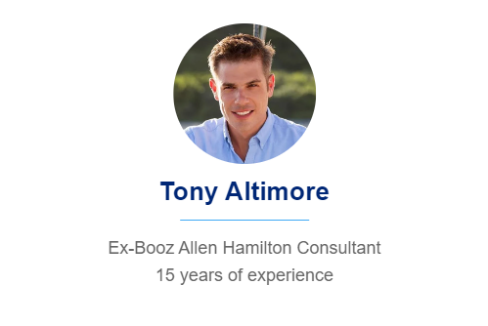
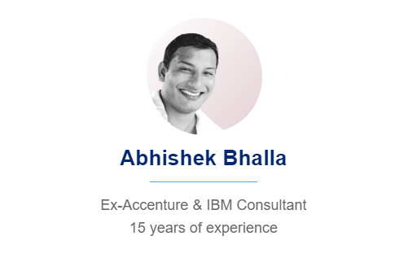
Need additional help? Send us a brief and we’ll find you the right talent from our network of 500+ tier-1 Management Consultants
Click here to send us a Project Brief

Slide 24

This was just a small preview.
www.domontconsulting.com

